Slide 1


Final Semester Project
Computer Networks
COMPANY NETWORKING
Team Member Names

Slide 2
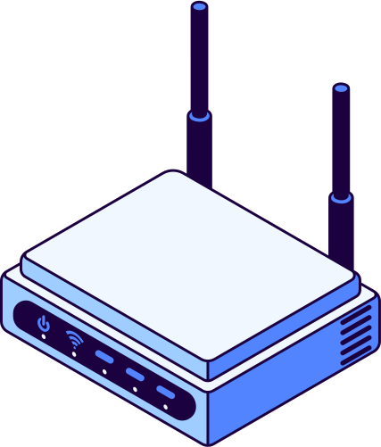
LEARNING OBJECTIVES
To understand how to set up a simple network for a company.
To establish effective communication between company offices.
To ensure secure data transfer within the network.

Slide 3


COMPUTER NETWORKING
Set Up
Network
Departments
Company has two floors connected with an email server
Each floor has its own network
Each floor has three departments.

Slide 4

The company is set up using 3 routers, 1 email server, 1 Access Point for each department connecting laptops and smartphones through wifi, 1 switch each department connected linking the PCs, 1 printer for one department, another 1 switch connecting three departments on one floor, 1 Router for 1 network at one floor.
SET UP OF NETWORKS
The term ‘computer’ can mean a range of different devices, including laptops, tablets and smartphones.

Slide 5

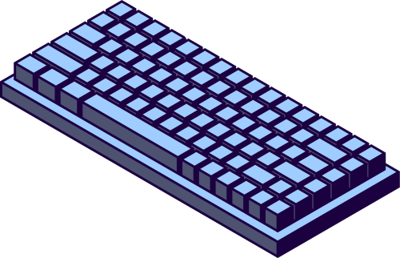
Divide a single physical network into multiple logical networks for better traffic management.
Restrict access to sensitive parts of a network by placing devices in different VLANs.
Contain broadcast traffic within a VLAN to improve network performance.
Group devices logically rather than
physically, making network management
more flexible.
VLAN
SET UP

Slide 6


VLAN
DATABASE

Slide 7



SUBNETTING
01
02
Network ID: 192.168.40.0
Broadcast ID: 192.168.1.63
Host range: 192.168.1.1-192.168.1.62
Network ID: 192.168.40.64
Broadcast ID:192.168.1.127
Host range: 192.168.1.65-192.168.1.126
03
04
Network ID: 192.168.40.128
Broadcast ID:192.168.40.191
Host range: 192.168.40.129-192.168.40.190
Network ID: 192.168.40.192
Broadcast ID: 192.168.40.255
Host range: 192.168.40.193-192.168.40.254

Slide 8
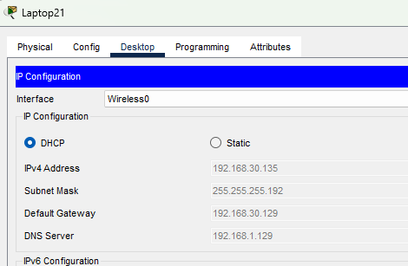
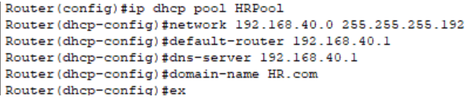
DHCP CONFIGURA-TION

Slide 9

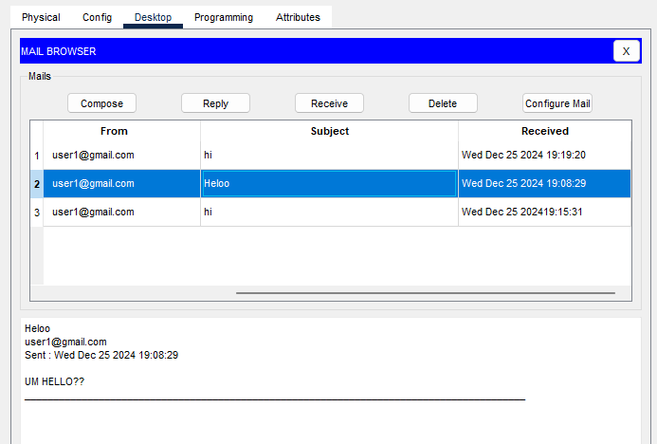
MAIL sent
EMAIL
MAIL recieved

Slide 10
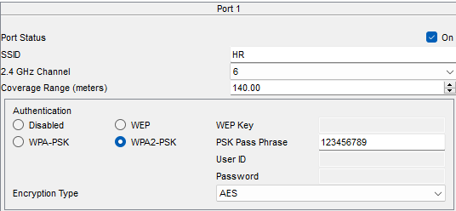
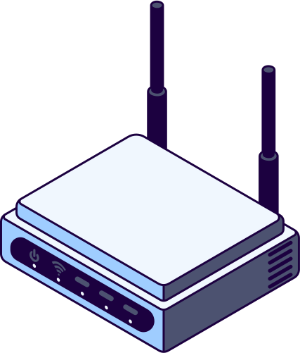
WI-FI

Slide 11
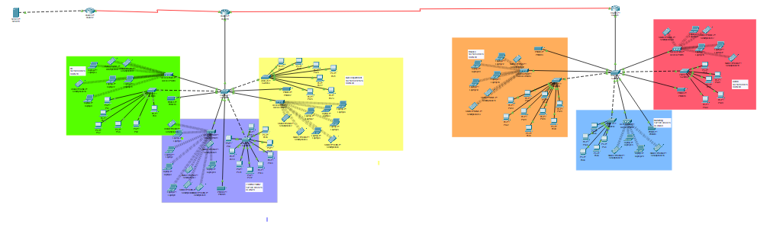
NETWORK

Slide 12
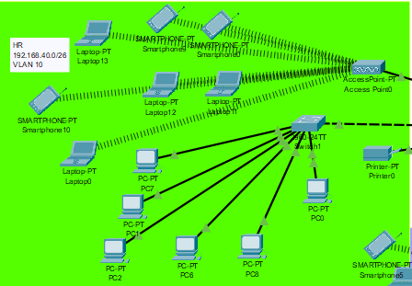
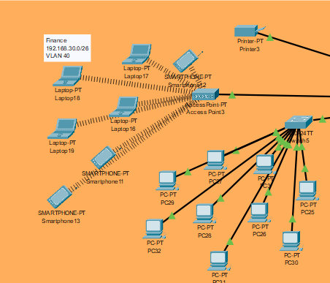

NETWORK

Slide 13
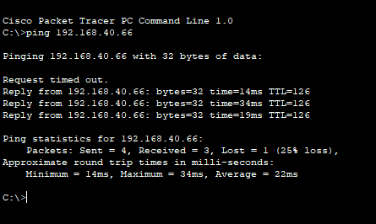
CONNECT-IVITY
(a PC from finance department communicating with laptop from it department)

Slide 14

Network configuration using Cisco Packet Tracer. IP addressing, subnetting, and routing protocols. Troubleshooting network connectivity issues. Understanding network security measures.
CONCLUSION
The project successfully demonstrated
how to create a functional and secure
company network. It highlighted the
importance of proper network
design for effective communication.
All objectives were achieved, including
seamless device communication and data transfer.

Slide 15
THANK YOU
:)

